Slide 1
Chapter 3
Determinants and Diagonalization

Slide 2
Contents
3.1. The cofactor Expansion
3.2.Determinants and Matrix Inverses
3.3. Diagonalization and Eigenvalues

Slide 3
The following statements are equivalent
A is invertible
detA≠0
The matrix equation AX=B has unique solution
The homogeneous system AX=0 has only trivial solution
A→Identity matrix by elementary operations

Slide 4
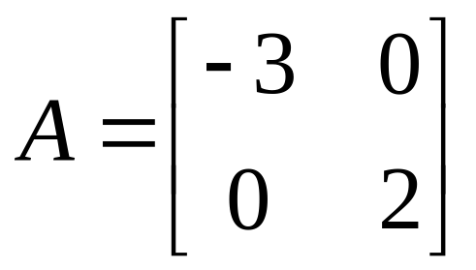
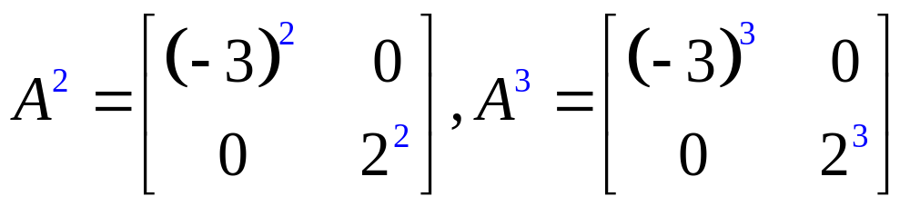
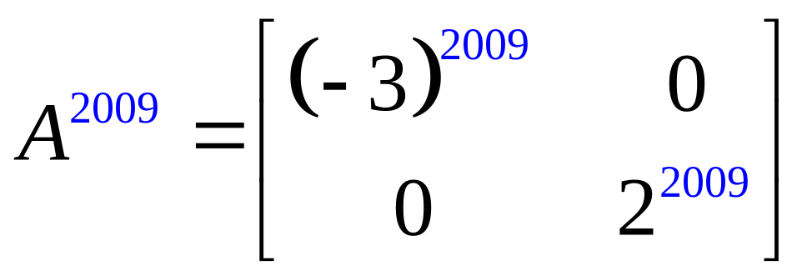
Example
Compute A²,A³, and A²⁰⁰⁹ if

Slide 5
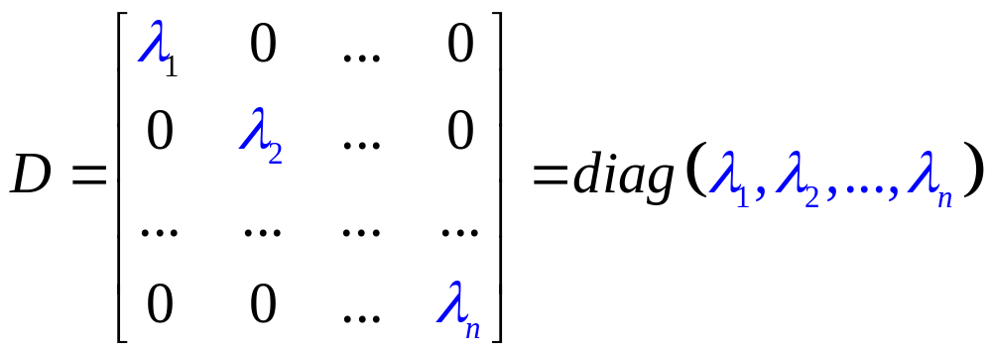
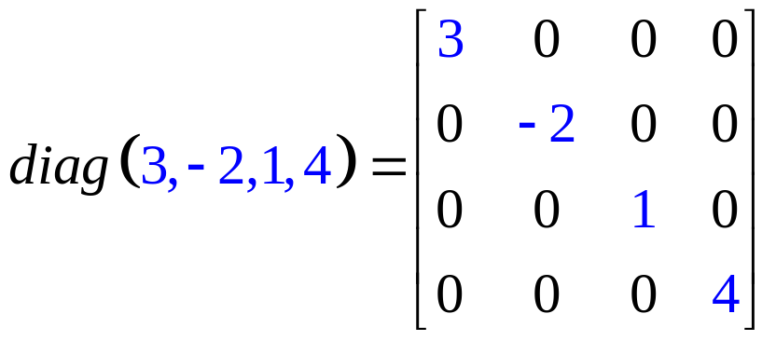
Diagonal matrices
An nxn matrix is called diagonal matrix if all its entries off the main diagonal are zeros
For example

Slide 6
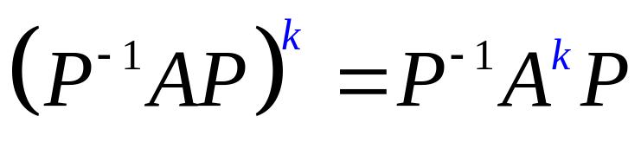
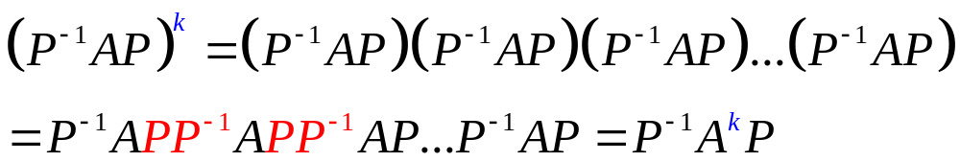
Theorem
If A is an nxn matrix and P is an invertible nxn matrix then

Slide 7
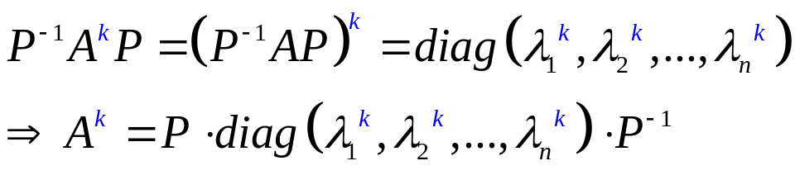
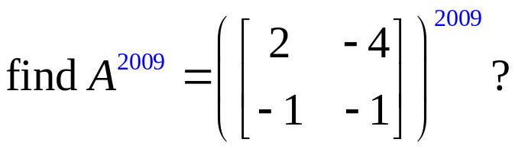
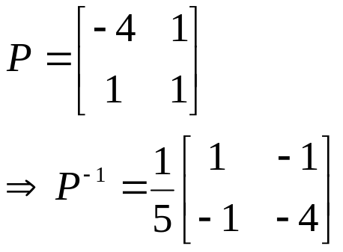
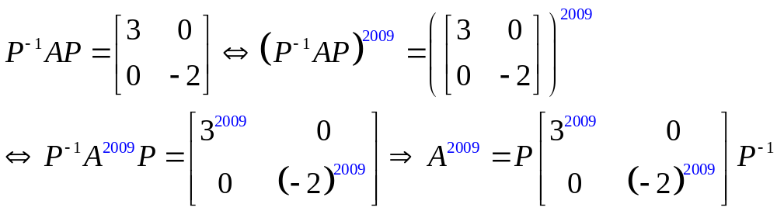
Diagonalization
Diagonalizing a matrix A is to find an invertible matrix P such that P⁻¹AP is a diagonal matrix P⁻¹AP=diag(₁, ₂,…, _{n})
Then, we have
Easy to compute A^{k}
For example,

Slide 8
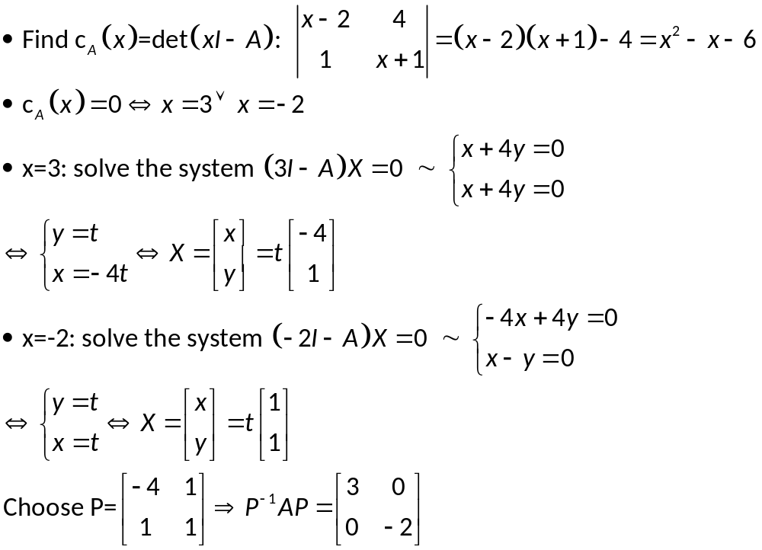
How to find P?
Đa thức đặc trưng
(characteristic polynomial)
Các giá trị riêng (eigenvalues) của A
Nếu t≠0 thì X=(-4t,t) được gọi
là véc tơ riêng (eigenvectors)
ứng với giá trị riêng x=3
Nếu t≠0 thì X=(t,t)
được gọi là véc tơ
riêng ứng với x=-2
Relationship between eigenvalues and eigenvectors
: eigenvalue (a number)
X: -eigenvector (remember: vector X≠0)
(I-A)X=0  AX=X

Slide 9
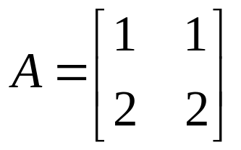
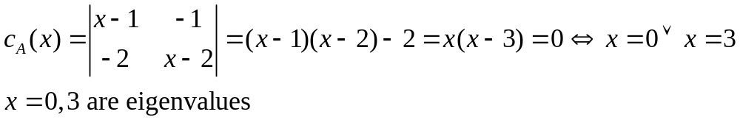
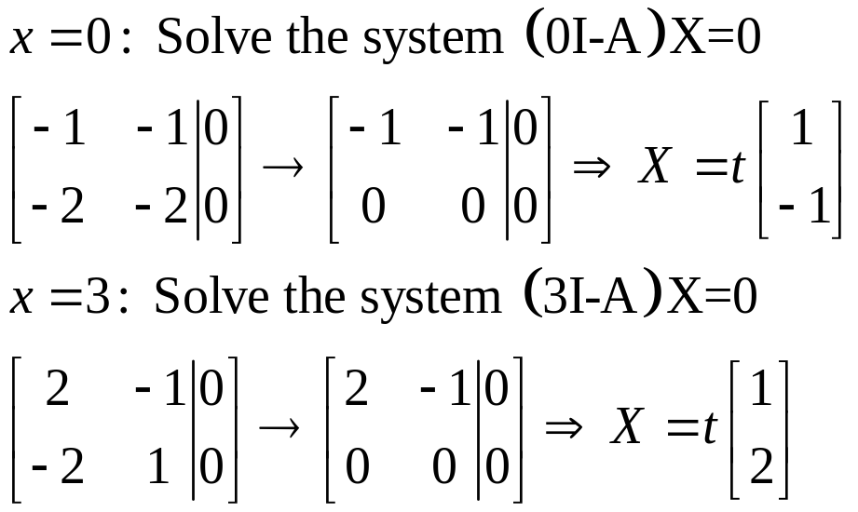
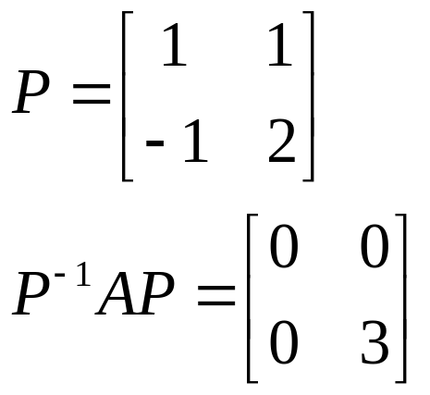
Example
Find the eigenvalues ang eigenvectors and then diagonalize the matrix
The characteristic polynomial of A is

Slide 10
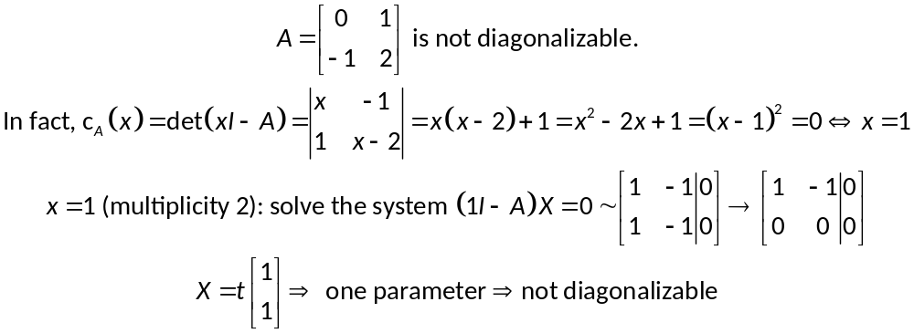
When is A diagonalizable?
Theorem
A is diagonalizable iff every eigenvalue  of multiplicity m yields exactly m basic eigenvectors, that is, iff the general solution of the system (I-A)X=0 has exactly m parameters.
For example,

Slide 11
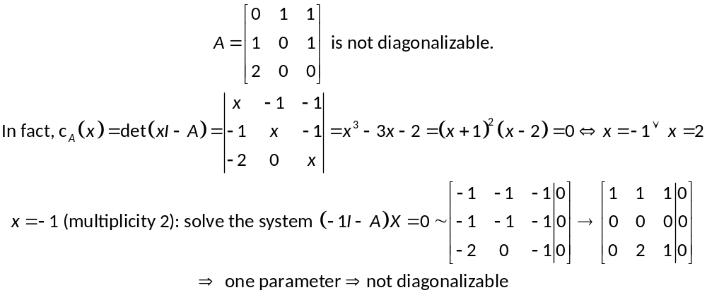
When is A diagonalizable?

Slide 12
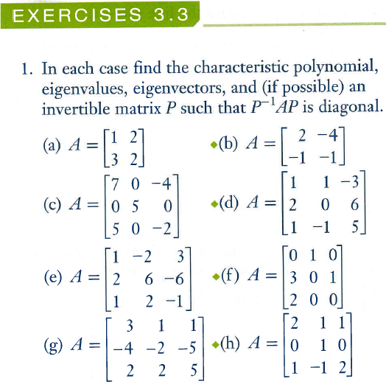

Slide 13
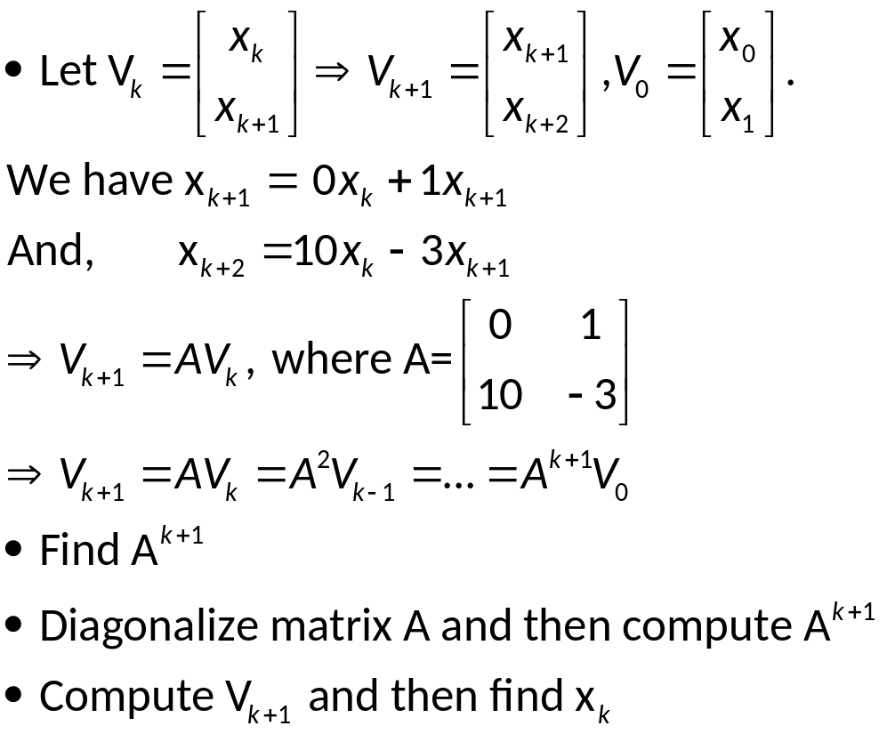
An Application to Linear Recurrences
Linear recurrence: x_{k+2}=ax_{k}+bx_{k+1}
How to find a formula of x_{k}?
For example, find x_{k} if x₀=1, x₁=1,and x_{k+2} = 10x_{k} - 3x_{k+1}

Slide 15
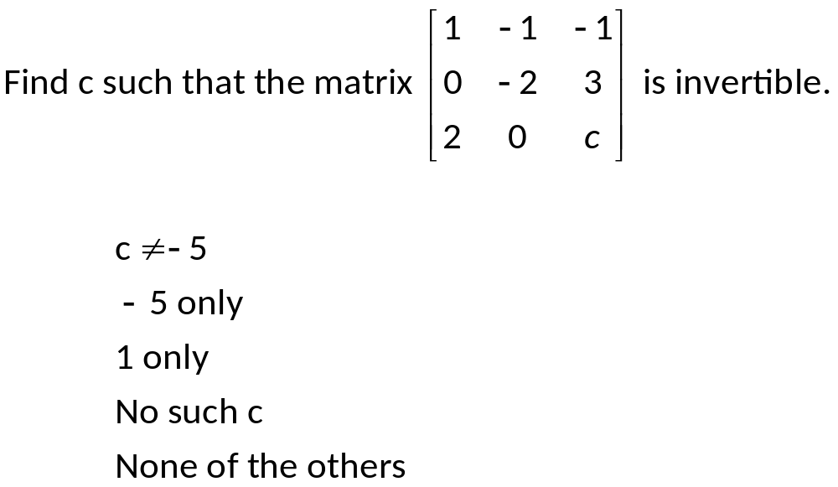
Exercises
Matrix A is invertible if and only if detA≠0

Slide 16
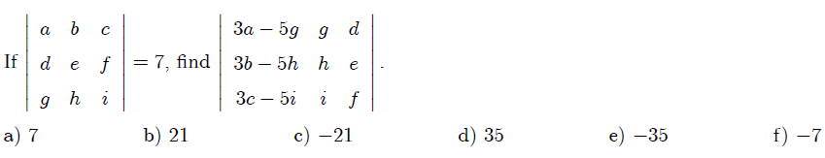
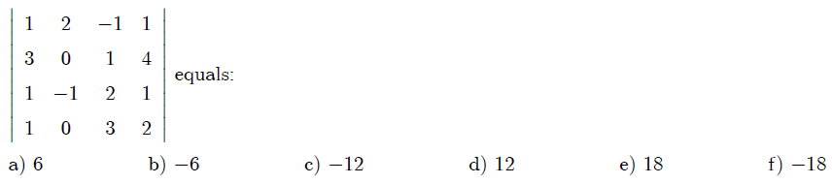
Answer: c)
Đổi chỗ hai dòng: định thức đổi dấu
Nhân một số k vào 1 dòng định thức nhân lên k lần
Cộng một bội của một dòng vào dòng khác: định thức không thay đổi

Slide 17
Exercises
Suppose A,B are 3x3 matrices and detA=2, det(B^{T})=-5. Find det(2AB) and det(A⁻¹B):
-80 , -5/2
-30, -5/2
-10, 10
10, 5/2
None of the others
detA⁻¹ =1/detA
det(AB)=detA.detB
det(kA)=k^{n}detA

Slide 18
Exercises
If A is 4x4 and detA = 2; find det(15A⁻¹ - 6adjA):
81/2
32
21
36/3
None of the others
A(adjA)=(detA)I
A⁻¹ =(adjA)/detA
detA⁻¹ =1/detA
det(AB)=detA.detB
det(kA)=k^{n}detA
det(A+B) ≠ detA+detB

Slide 19
Let A be an 3x3 matrix has three eigenvalues 1, -2, 3. Find its determinant.
A. not enough data to find.
B. 2
C. -6
D. 0

Slide 20
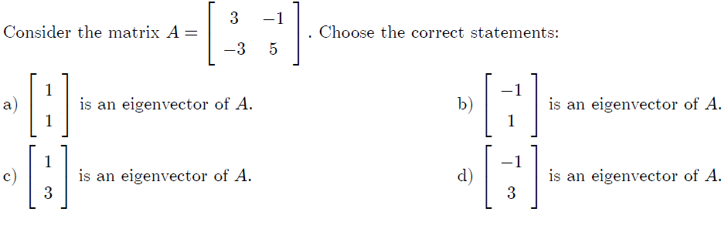
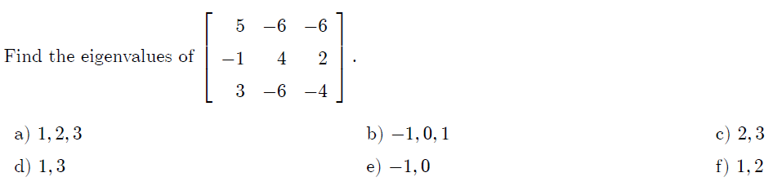
Answer: a,d
Answer:1,2

Slide 21
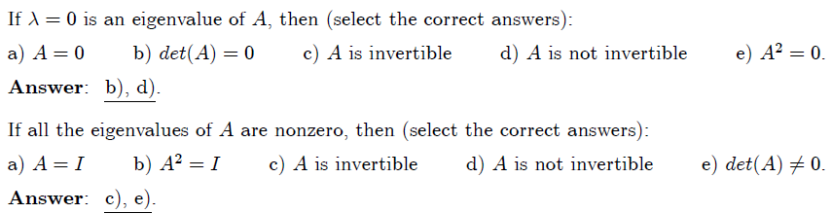

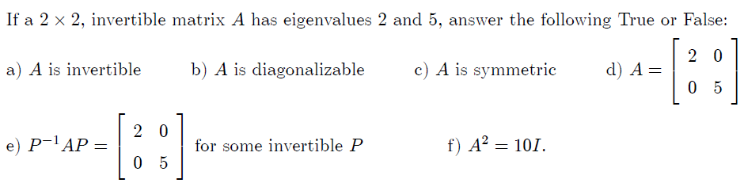

Slide 22
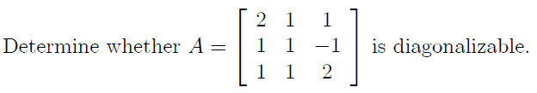

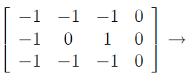

c_{A}(x)=(x-1)²(x-3)=0 ⇔x=1 or x=3
x=1 (multiplicity 2)
Solve the system (1I-A)X=0
Not diagonalizable
only one parameter

Slide 23
Thanks
Notes:
P.166: 1a-l

